Slide 1
Silage production
When does it start ?
→ agrotechnics, field work
→ the path to the production starts in the field
When does it end ?
→ by harvesting / loading and feeding

Slide 2
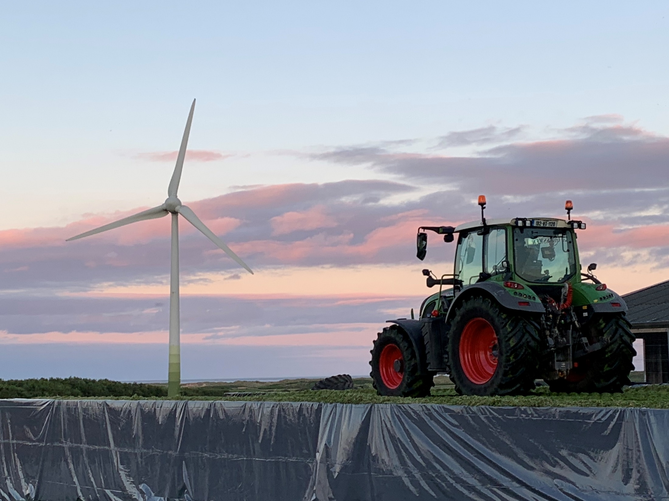
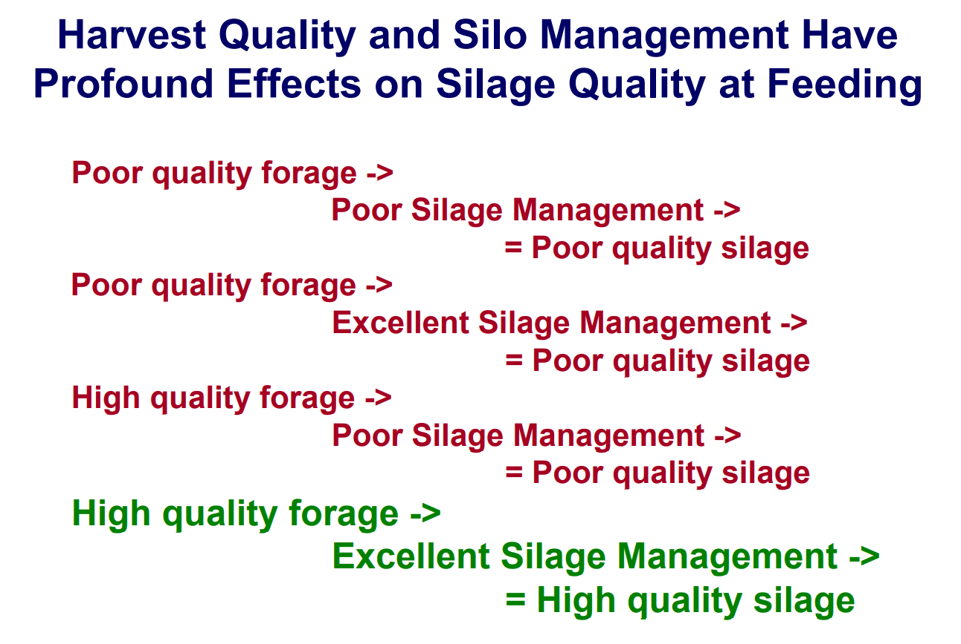
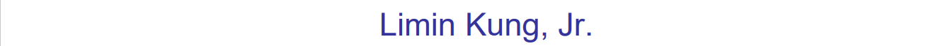
Notes:
High quality, low losses, high losses

Slide 3
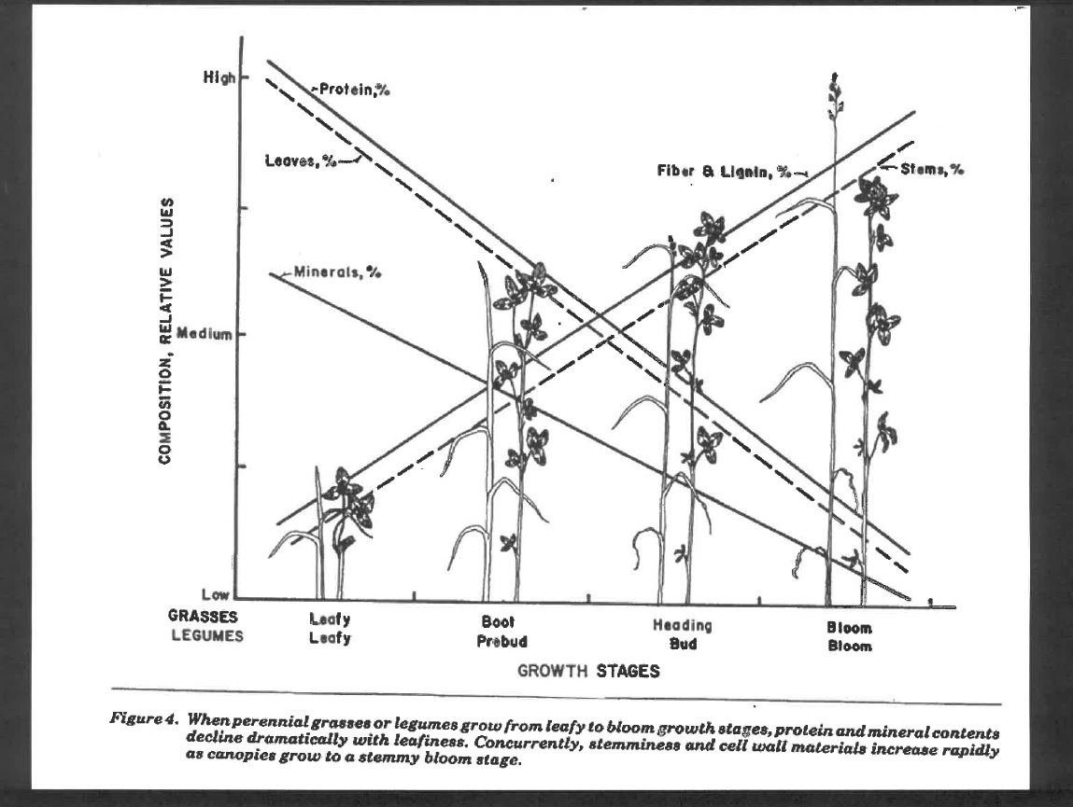
Effect of Growth Stage on Crude Protein, Crude fibre and Mineral Content (grass, legumes)
crude protein
crude fibre
and lignin
Minerals

Slide 4
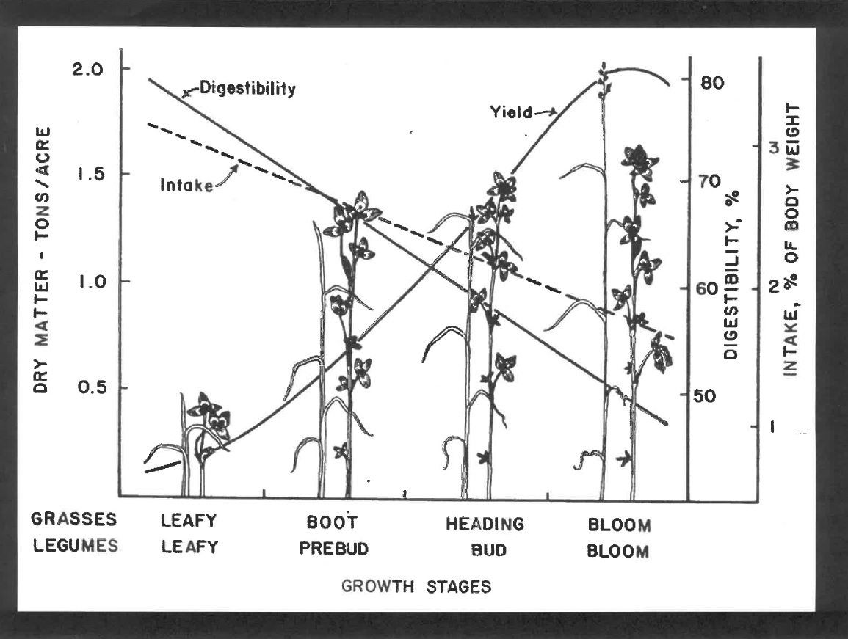
Effect of Growth Stage on Forage Production, Dry Matter Intake DMI and Digestibility (grass, legumes)
digestibility
production
DMI

Slide 5
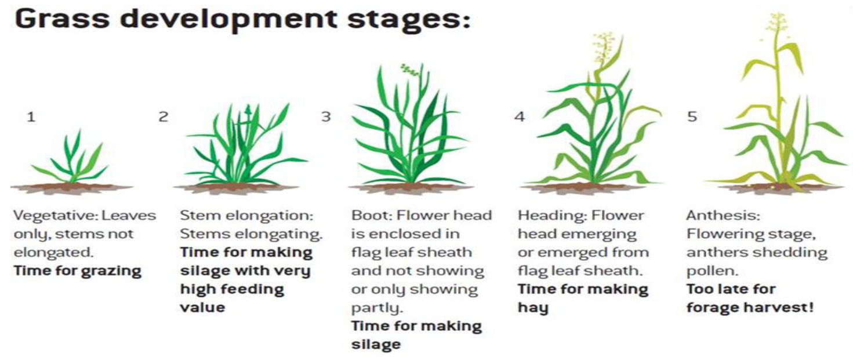
Growth stage
Grass

Slide 6
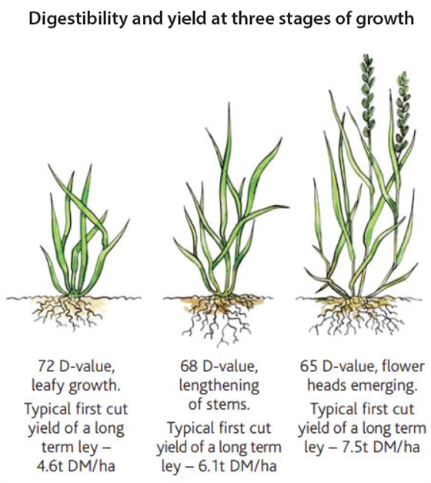
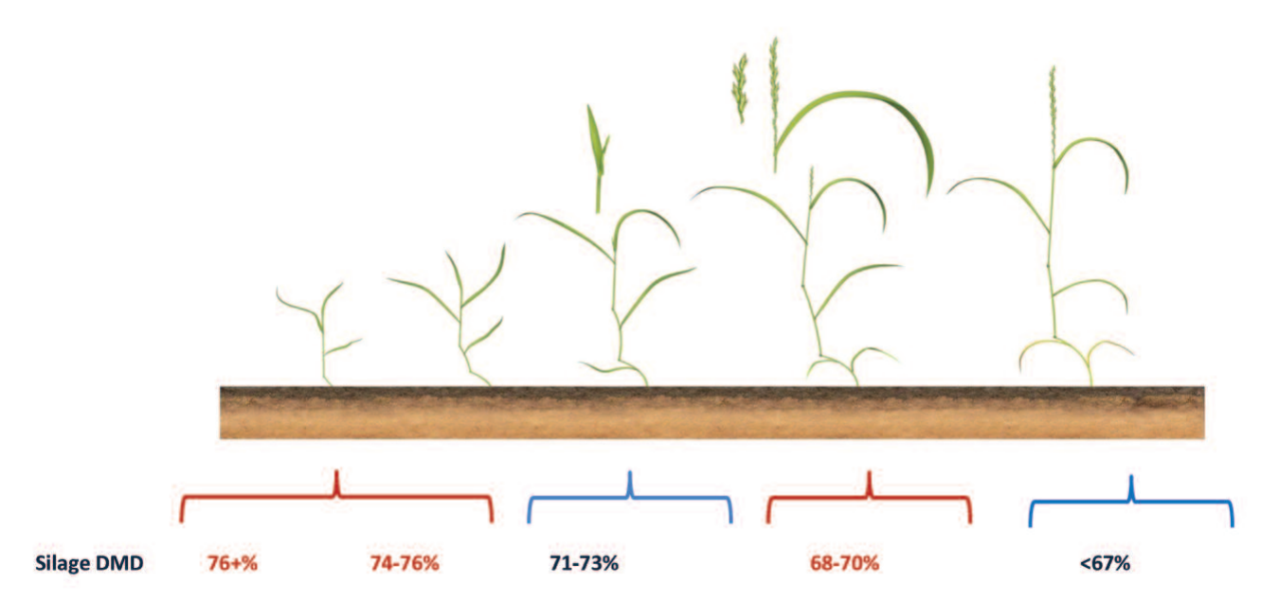
Growth stage
Grass
Digestibility and production
Notes:
Early boot 75dmd

Slide 7
Optimal forage maturity
Optimal time – date of harvest
Crop | Optimal vegetation phase
Alfalfa (lucerne) | Period of formation of flower buds (butonization)
Clover | Beginning of flowering
Corn | Milk-wax maturity of grain, dry matter of whole crop: 30-33%
Grass | Period of flowering
Rye | Flowering (dry matter 20-23%) to milk-wax maturity (dry matter 35-40%)
Beans | Milk maturity of lower hulls
Whole grain crop | Milk-wax maturity of grain
Legume-cereal crop | Cut when cereal crop is in milk-wax maturity

Slide 8
Influence of grass harvesting date on fiber content and digestibility
Vegetation stage | Fiber content in dry matter (%) | Organic matter digestibility (%)
Throwing | 22-25 | 73-78
Beginning of flowering | 26-28 | 66-72
End of flowering | 29-32 | 60-65
Obsolote vegetation | above 32 | below 60

Slide 9
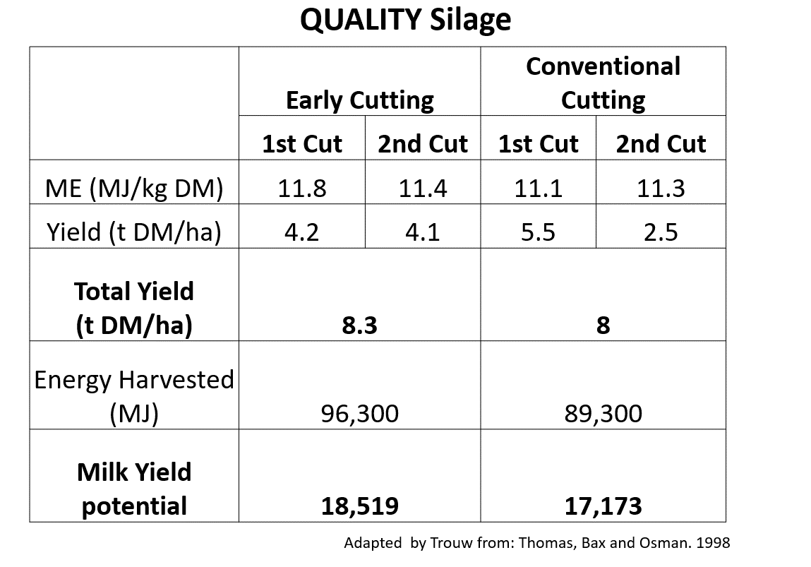

Slide 10
Influence of alfalfa vegetation stage on nutrient content in dry matter (g/kg)
Vegetation stage | Crude protein | Fiber | NEL (MJ)
Butonization | 220 | 250 | 5,5
Beginning of flowering | 180 | 285 | 5,1
End of flowering | 170 | 345 | 4,7
After flowering | 160 | 385 | 4,5

Slide 11
Delaying the alfalfa harvest by 1 day will show
Lowering the crude protein content by o 0,5 %
Increasing ADF content by 0,7 %
Increasing NDF content by 0,9 %

Slide 12
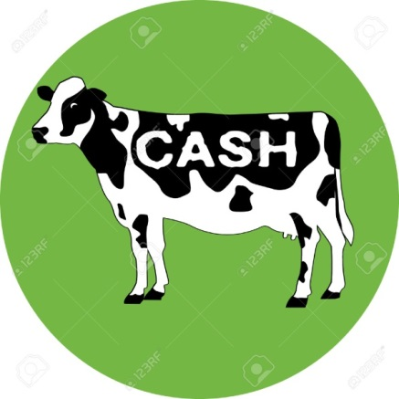
Good quality silage increases fiber (NDF) digestibility
Cows respond to any 5% increase in NDF digestibility:
Increase of DMI (dry matter intake) by + 0,63 kg
Increase of avg. daily milk prouction by + 0,9 kg
(Oba & Allen 1999, Jung et al 2004, Ferraretto & Shaver 2013)

Slide 13
Harvesting the grass a bit later: ➔ means less protein and higher cost
range: 9,24-15,50% CP
average: 12,5% CP
Very good grass silage: above 18% CP
CP deficit | 1kg DM | 5kg DM
12,5% CO in 1kg DM | 125 g CP | 625 g CP
18% CP in 1kg DM | 180 g CP | 900 g CP
Deficit |  | 275 g CP
Mix urea 2565g CP = 40Kč/kg |  | → 107 g of product
extra cost for 1 feeding day |  | → 4,28 ZMW for 1 FD
extra cost for 300 cow for 30 days |  | → 38.520,- ZMW
…How to make money without spending it…

Slide 14
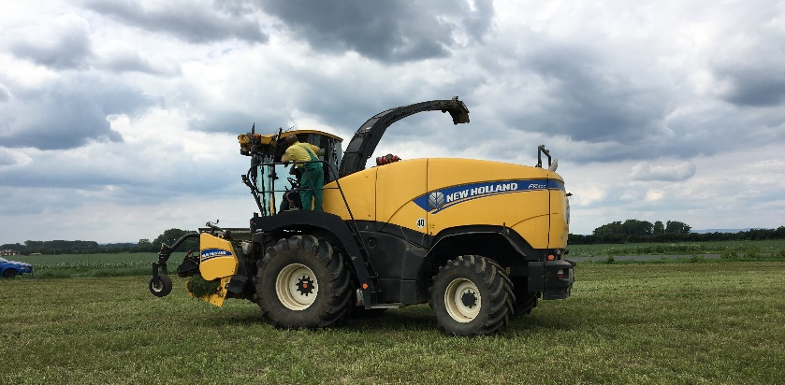
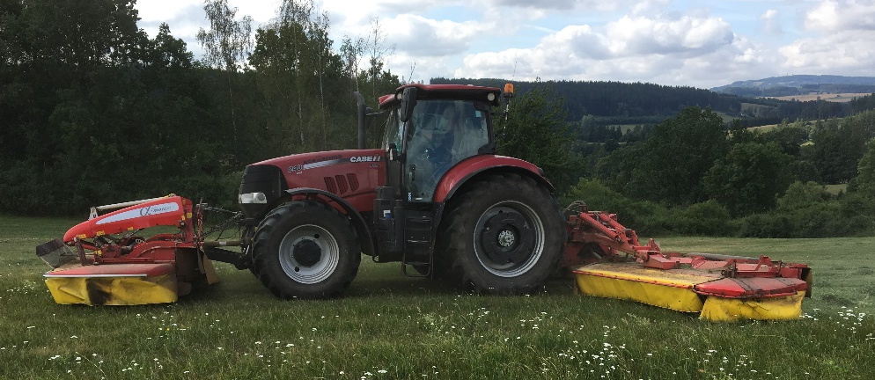
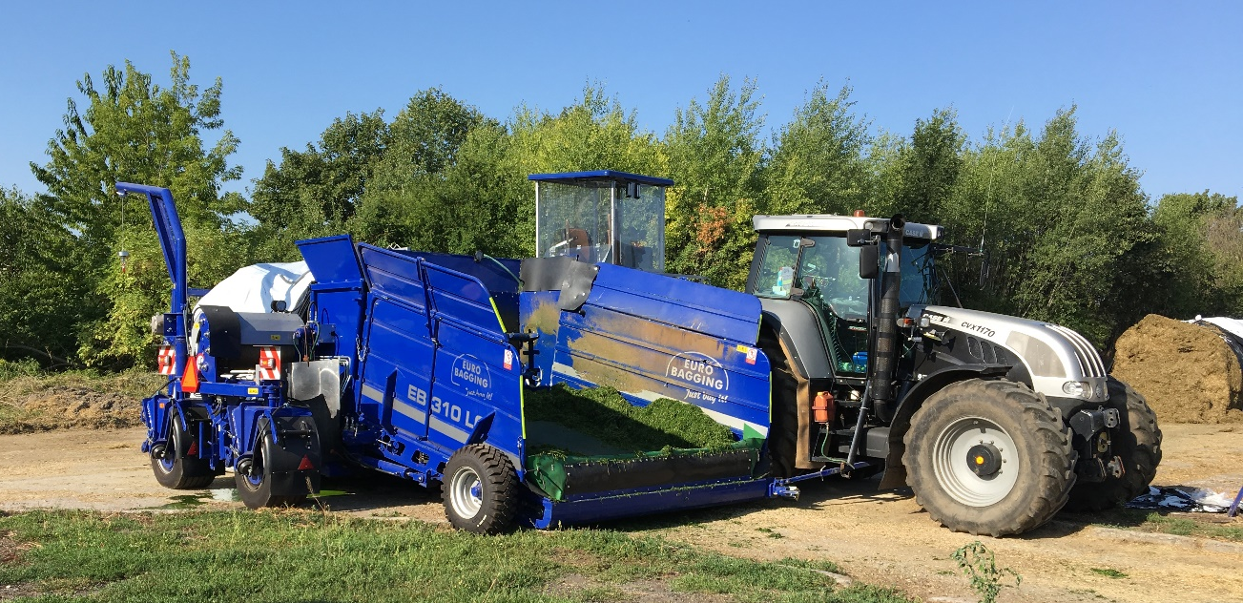
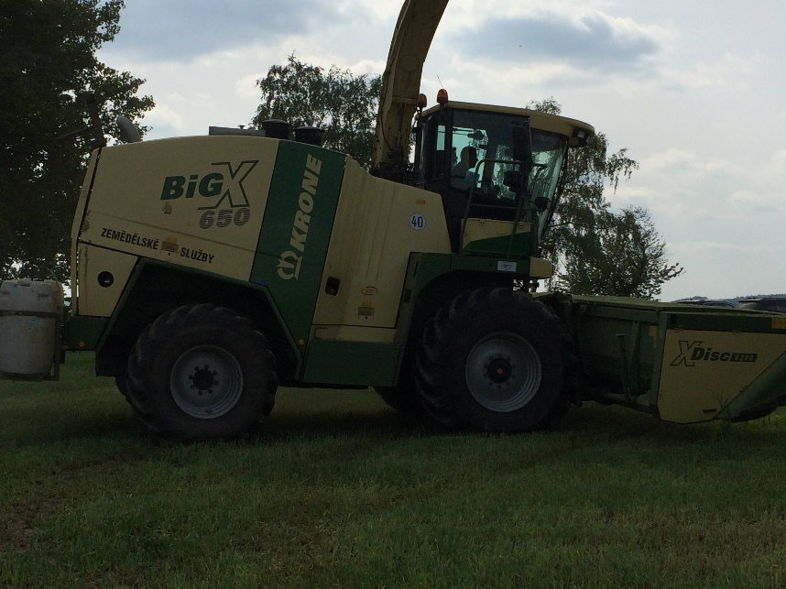
Preparation of silage line machines
➢ sharp-edged knives of cutting apparatus
perfect straight and clean cut
jagged ends after cutting
- plant dehydrates, weakens
- poor re-grow and offshooting
➢ condicioners
speed-up of wilting
➢ preparation of machines
for silage bags and bales

Slide 15
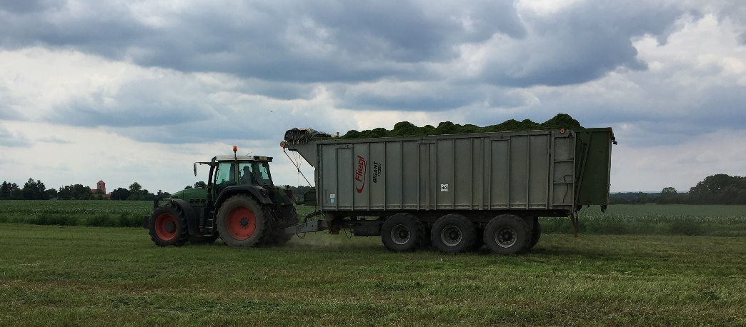
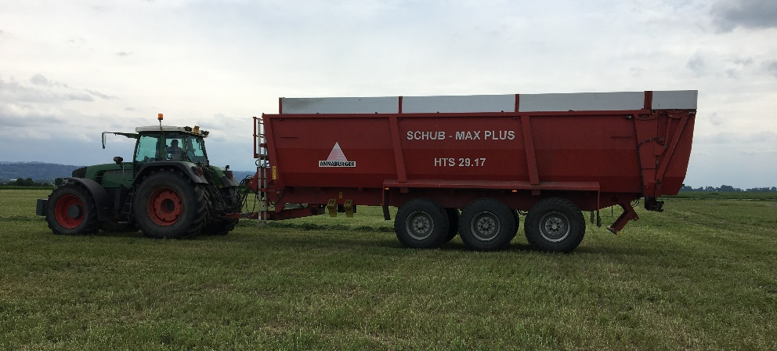
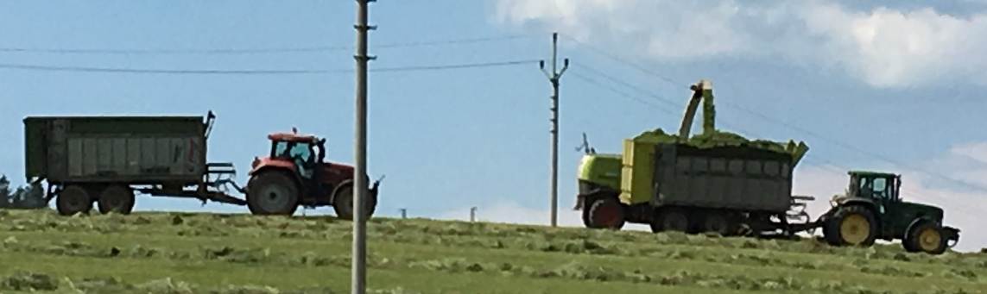
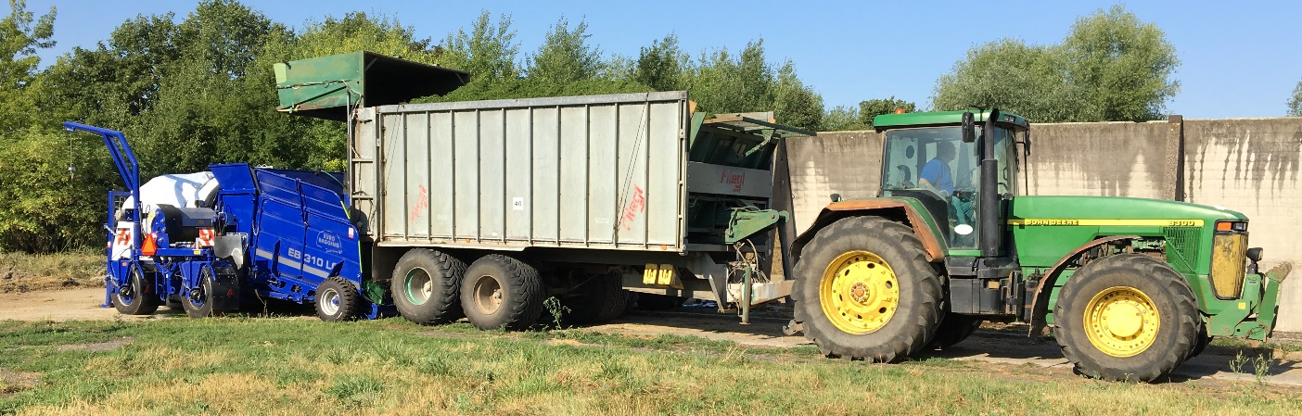
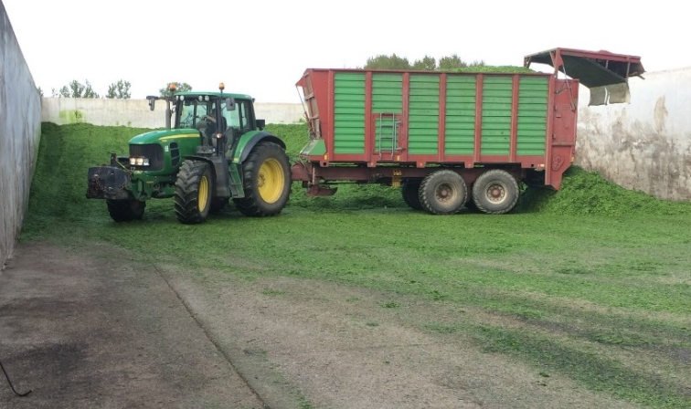
Transport line
trucks
tractor semitrailer
haylage trailers
conflict:
capacity – speed of transport into silage pit
versus intensity of forage clamping (2 – 4 minutes per 1 ton)

Slide 16
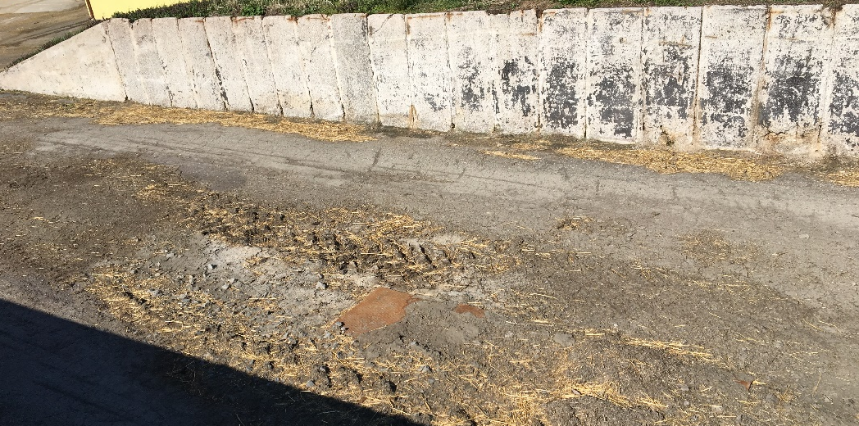
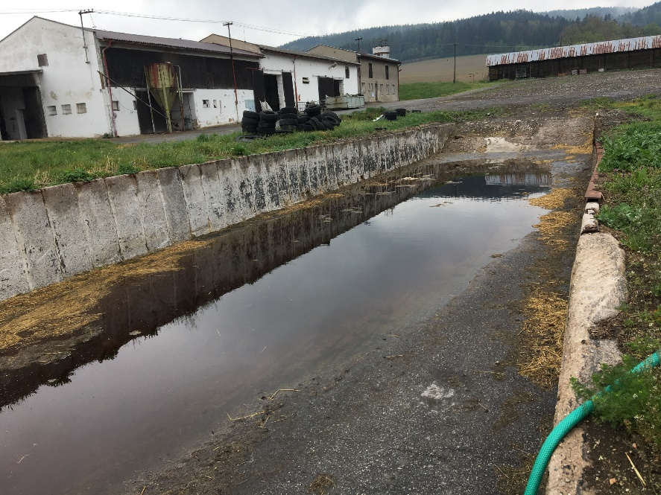
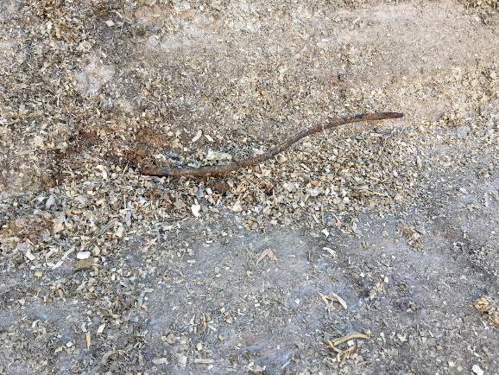
Preparation of silage pit
→ clean out leftovers of silage, soil, stones, etc.
→ cut off armature, wires – damage of tires, damage of loading machine of mixing wagon
→ clean out channels and sumps for silage effluent
→ wash silage pits with clean water
→ disinfect silage pits – finely ground limestone
Why to disinfect silage pit?
We request the driven fermentation
no environmental bacteria and yeasts are
allowed to „digest“ crops and to degenerate
fermentation to spoilage

Slide 17
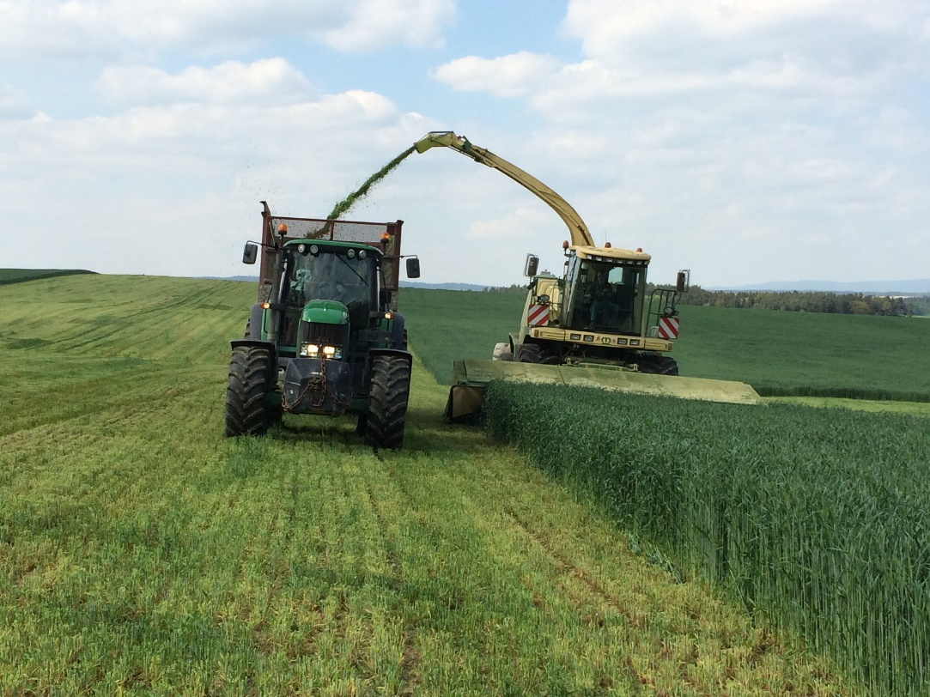
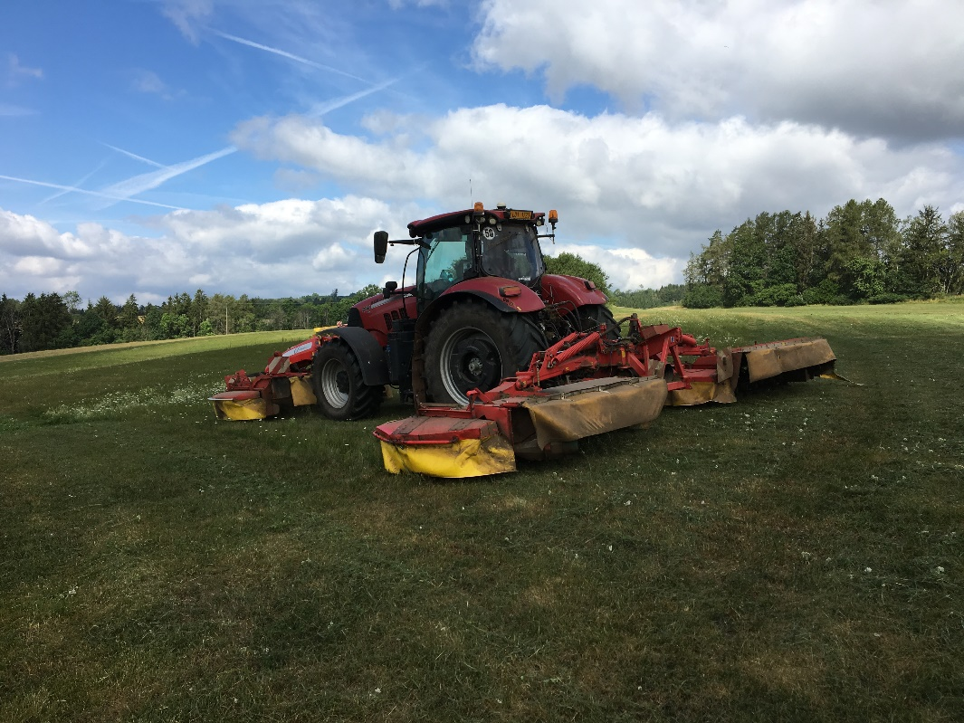
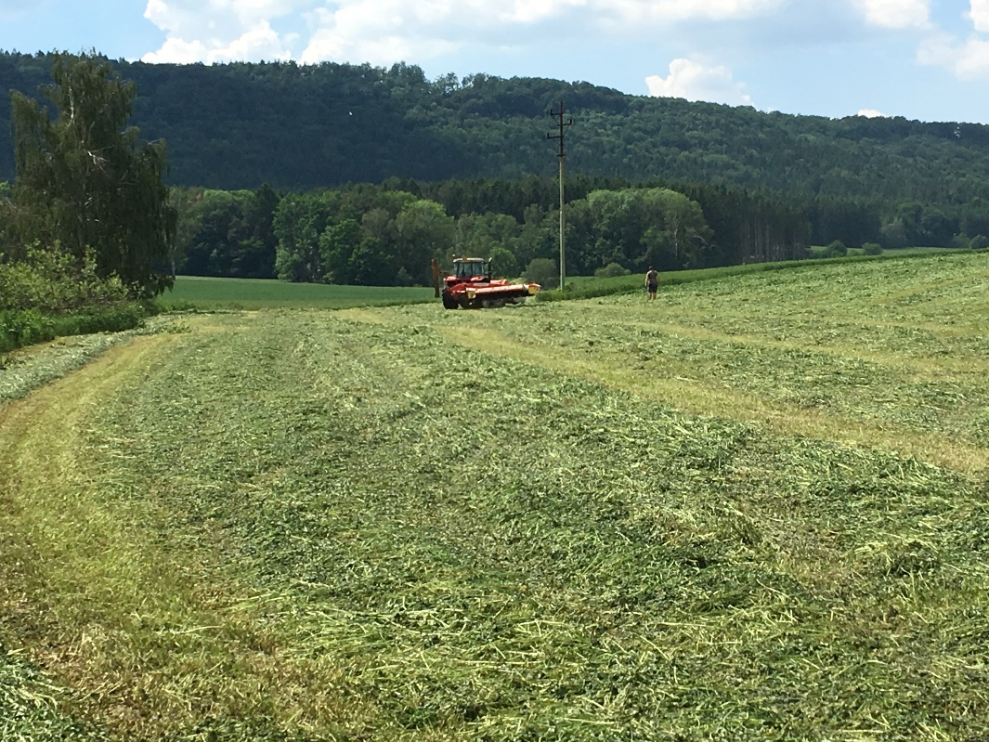
Harvest - day „D“
goal ➔ to harvest crop in the
optimal maturity stage and material
to preserve at the ideal dry matter
for several months
☞ ideally when the dew falls off
☞ ideally after midday, when plants contain the most of sugars for lactic fermentation
☞ wilting overnight

Slide 18
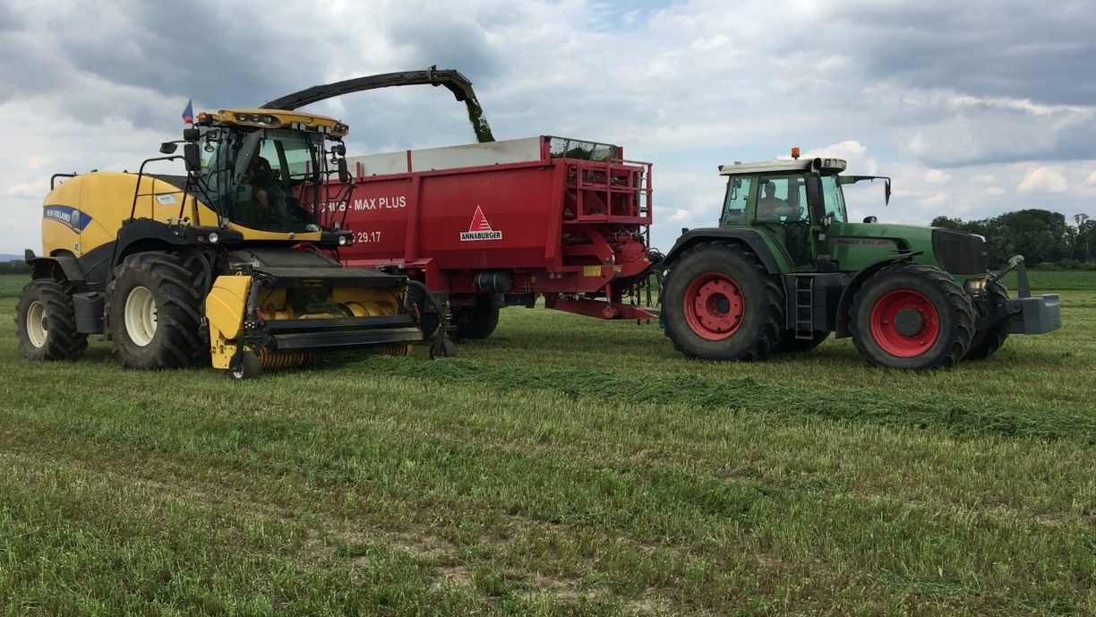
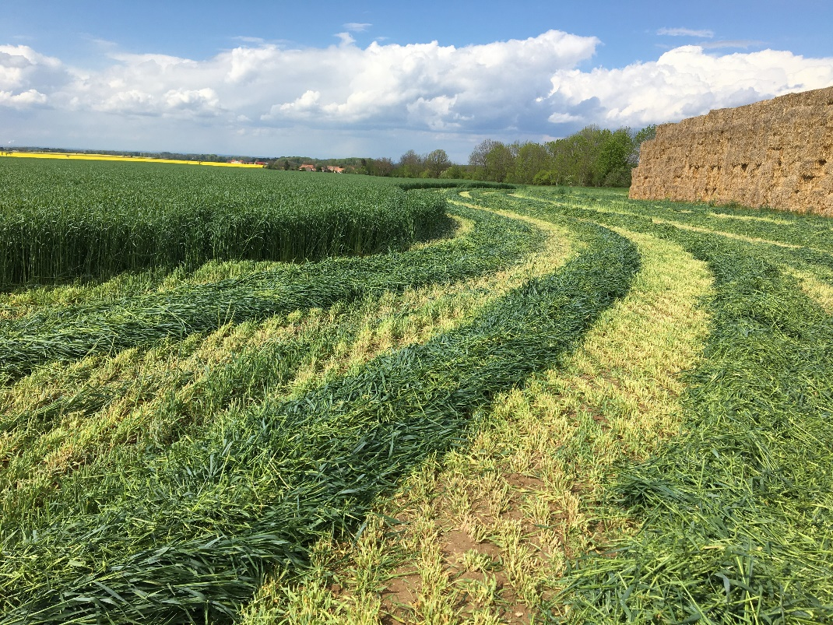
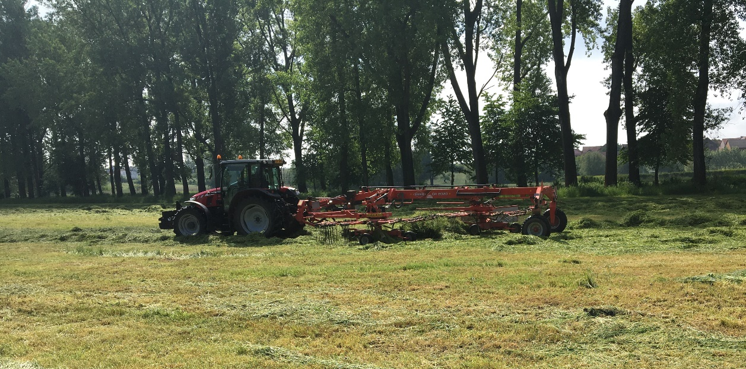
Stubble
grass 5 cm
legumes 8 cm
- re-grow of plants in the field
- harvesting without admixture of soil

Slide 19
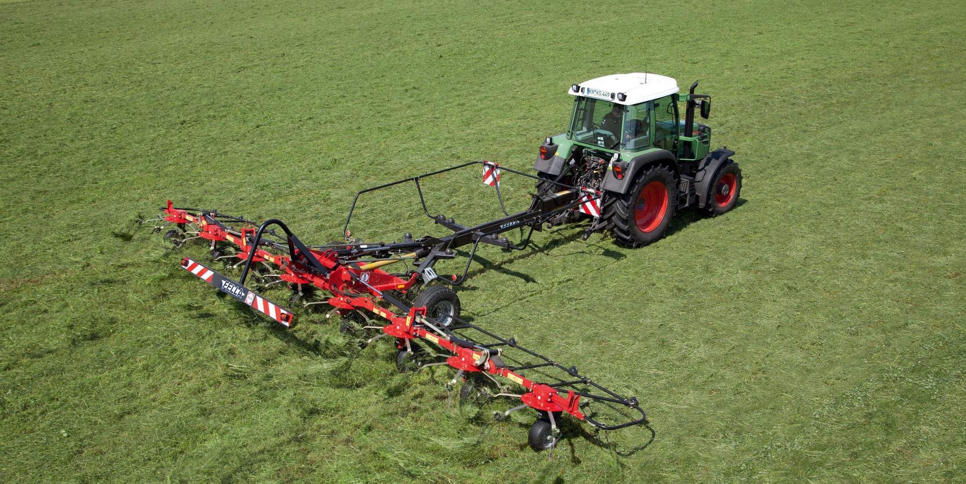
28%<DM<35%
If using high DM Inoculant
=> Promote intakes
Rapid Wilt
<24 hours
Notes:
Wide swath in good weather

Slide 20
Optimal dry matter and chop length
Dry matter and length of cutting:
alfalfa 35-40% DM cuttings 15-25 mm
clover 35-40% DM cuttings 20-30 mm
grass 30-40% DM cuttings 30-40 mm
rye 30-40% DM cuttings 30-40 mm
Start cutting crops of worse quality then better crops, harvest before flowering to stock up better crops on the top in the silage pit ➔ to avoid problematic clamping, spoilage, effect of yeasts, molds.
Higher dry matter ➔ shorter cutting

Slide 21
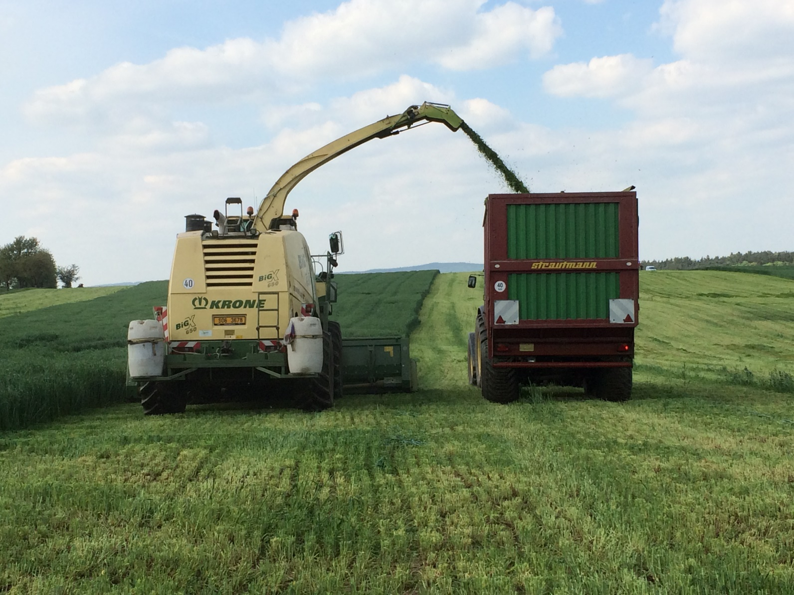
WE MUST CONTROL
THE FERMENTATION PROCESS

Slide 22
Application of silage inoculants FORMASIL
inoculant | composition | notes
Formasil | Pediococcus pentosaceus | gras, clover-gras
 | Beta glucanase
 | Xylanase
Formasil Alfa | Pediococcus pentosaceus | alfalfa, clover
 | Lactobacillus plantarum
 | Beta glucanase
 | Xylanase
Formasil Cool | Pediococcus pentosaceus | higher dry matter
1st cuts/harvest | Lactobacillus buchneri | aerobic stability
rich in sugars | Beta glucanase | clover-gras
 | Xylanase | alfalfa, clover
Formasil Maize | Pediococcus pentosaceus | corn
 | Lactobacillus buchneri
Rapid drop of pH
Retention of stability at feed out
Decrease numbers and growth of yeasts and molds
Protect against secondary fermentation at feed out
Increase palatability of silages
Shelf life 48 hours after dilution
… experienced Pediococcus pentosaceus
Short generation interval – bellow 20 minutes
Wider ratio of optimal temperature and pH for growth
Good growth at cold conditions
Ability to produce bacteriocins – inhibit growth
of some other bacteria and kill off listeria

Slide 23
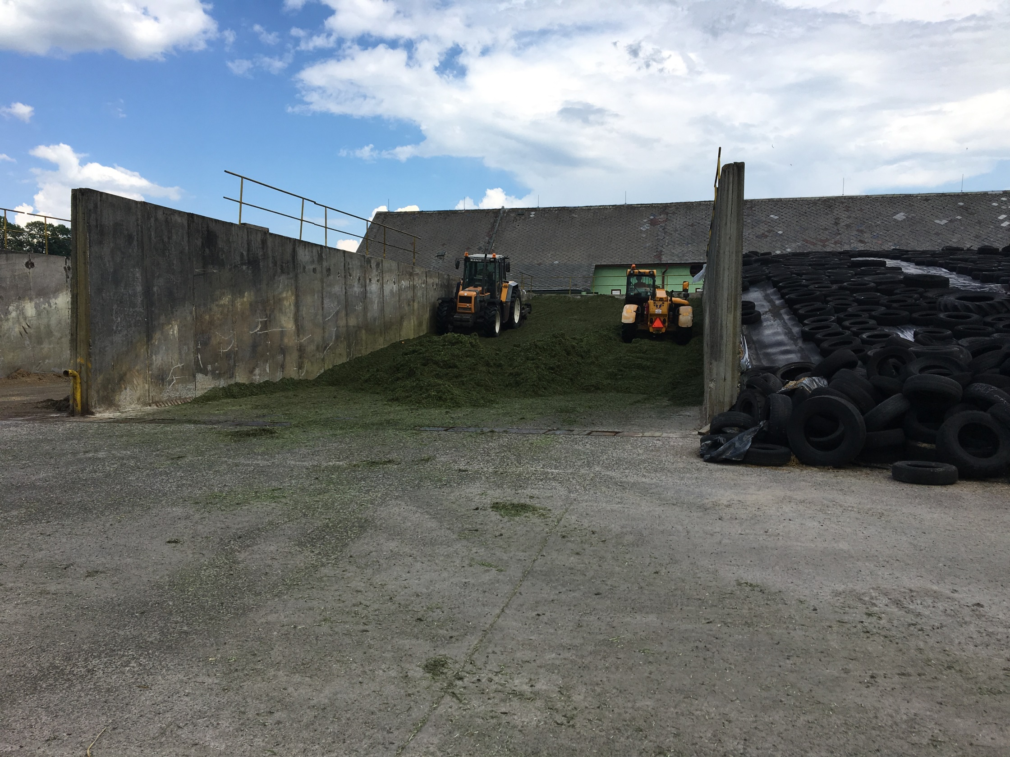
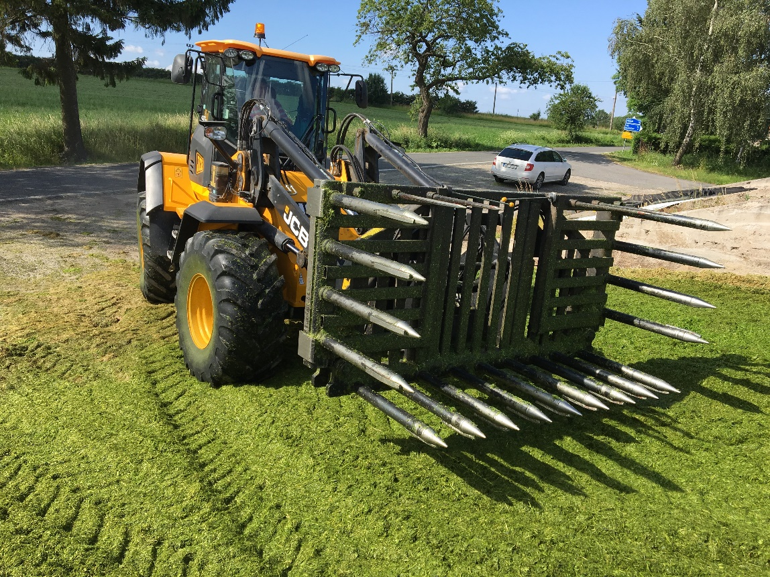
Layering
Height of clamped layer 15 – 25 cm

Slide 24
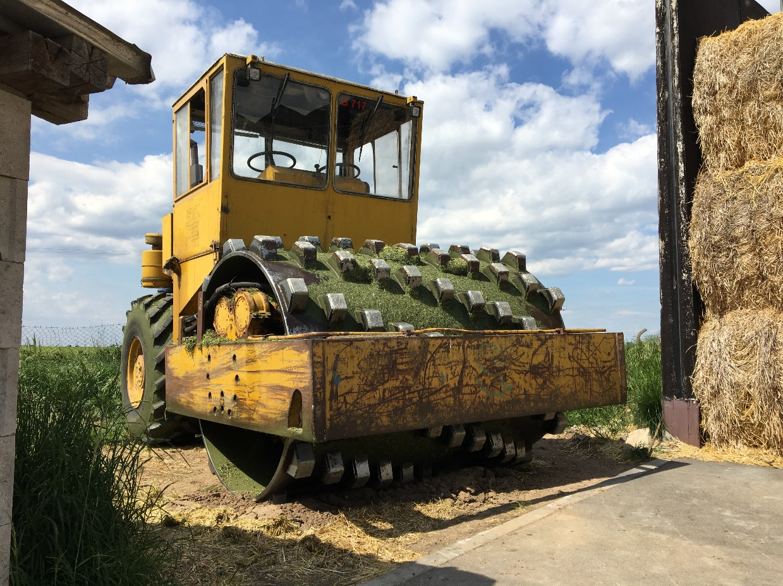
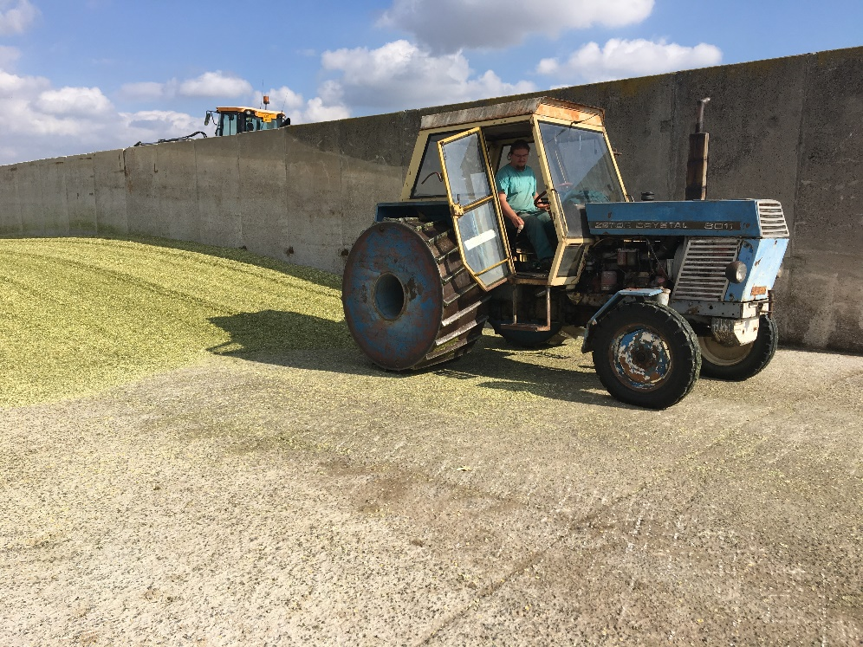
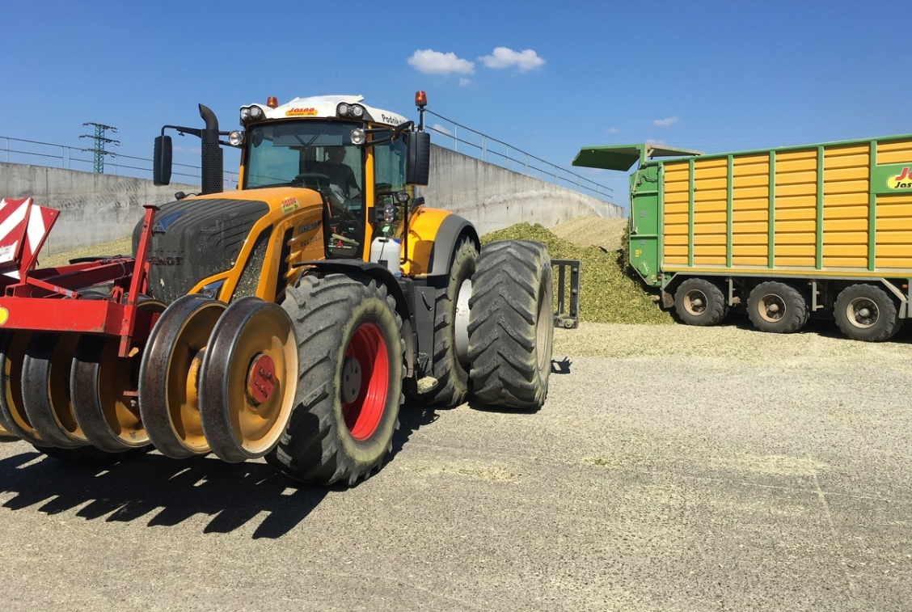
Clamping
! NO doublemounting of wheels !
➔ Lower pressure
→ Good for fields
→ Wrong for silage clamping

Slide 25
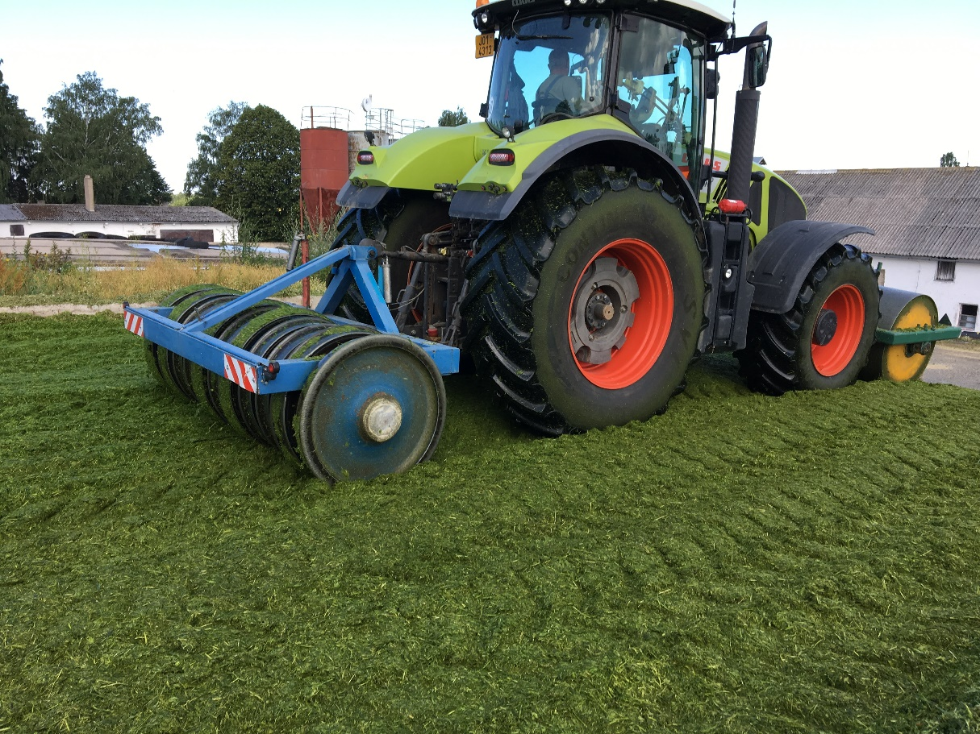
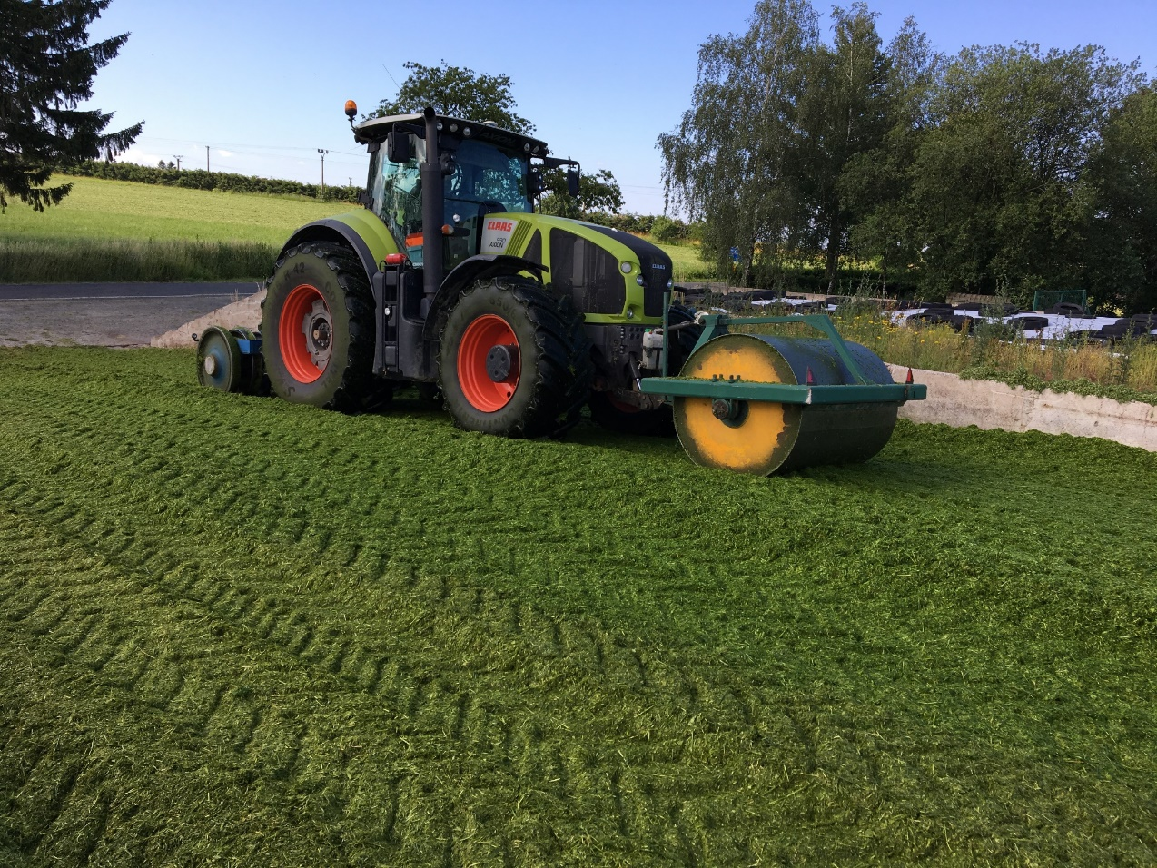
Clamping

Slide 26
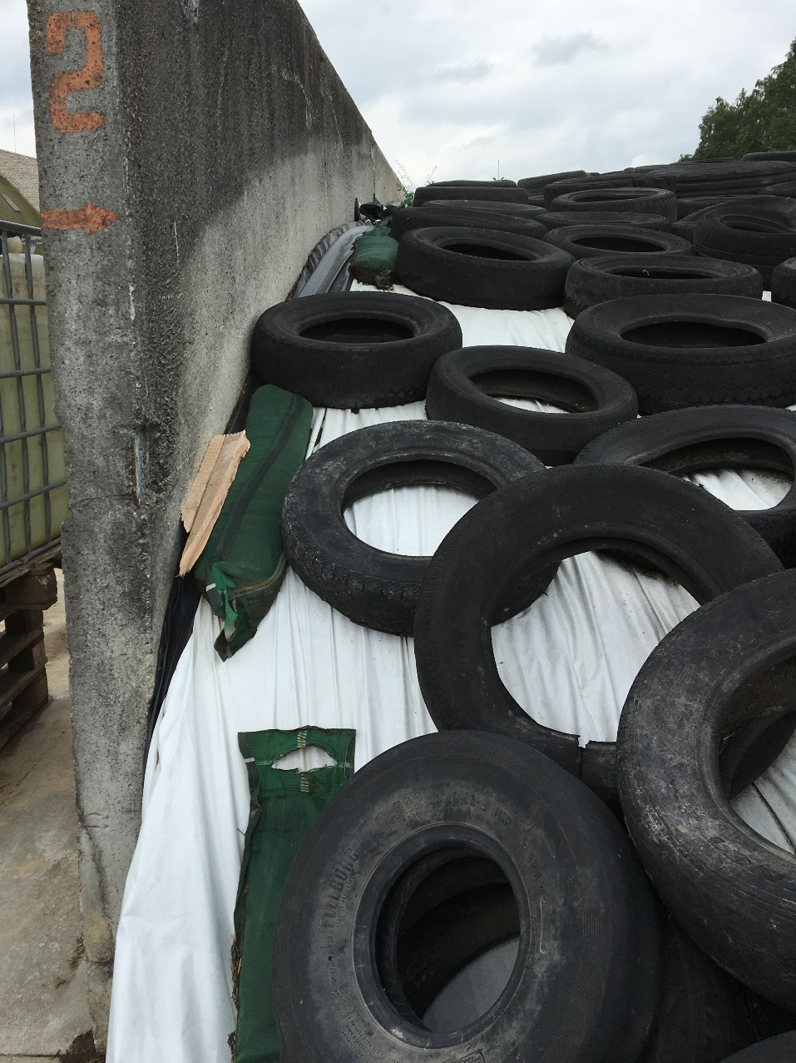
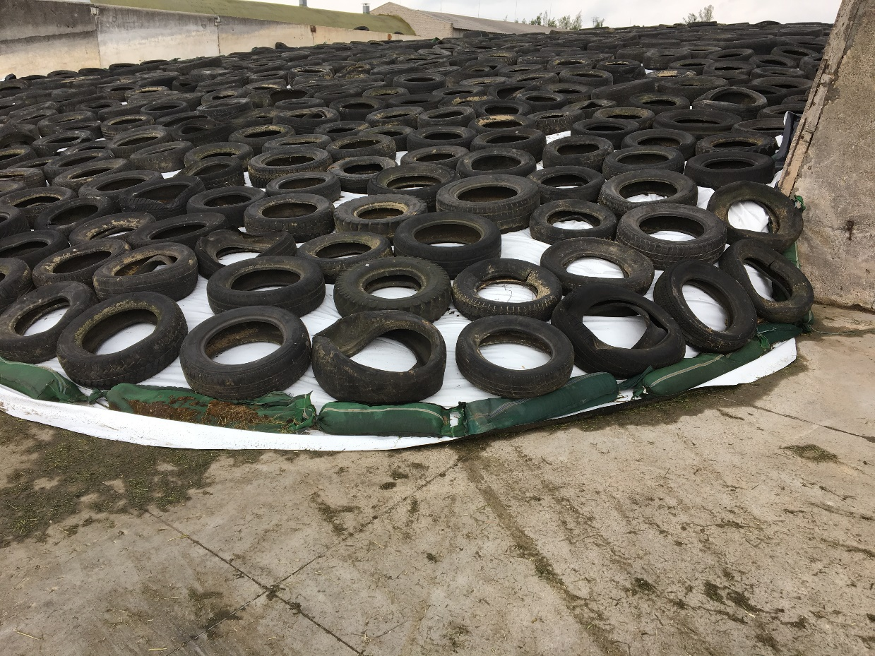
Load bags along the walls and at the end of silage pit

Slide 27
Fermentation and maturation of silage
bacteria from Formasil Maize inoculant – produce lactic acid that preserves silage
Drop of acidity in silage
pH to 4,2 (4,0 – 4,5) within 5-6 days after cover
lactic acid fermentation will not start until all air with oxygen is removed from ensiled crop
Maturation – minimum 6 weeks to achieve STABILITY
opening silage pit to early – risk of spoilage and losses
secondary fermentation
– yeasts: non-visible process, high warming of silage above ambient temperature
– molds: when visible (black color or white spots), it is already to late
➔yeasts destroy silages as the first

Slide 28
Ways to increase conservation efficiency of silage from forage
The correct process of ensiling and adherence to technological principles
To ensure the driven fermentation
☞ Formasil®
To ensure the correct way of corn
silage loading from pit

